Slide 1
DEADLOCK AVOIDANCE THROUGH EFFICIENT LOAD BALANCING
By SANDHYA S 19BCE1614, JANANYA SIVAKUMAR 19BCE1602,
SHRAVAN GANAPATHIRAMAN 19BCE1703, TEJAS V 19BCE1607, RAM 19BCE1162

Slide 2
WHAT IS DEADLOCK?
Deadlock is defined as the permanent blocking of a set of processes that compete for system resources, including database records or communication lines.
DEADLOCK AVOIDANCE
In deadlock avoidance, the request for any resource will be granted if the resulting state of the system doesn't cause deadlock in the system. The state of the system will continuously be checked for safe and unsafe states.
One of the applications of deadlock avoidance is to allocate all required resources to the process before the start of its execution, this way hold and wait condition is eliminated but it will lead to low device utilization.

Slide 3
OVERVIEW
Many users use the same platform concurrently, so there is a huge demand of resources which sometimes cause deadlock condition.
Using cloud computing implementation of detection and avoidance algorithm of deadlock to prevent cloud disaster in cloud computing

Slide 4
Deadlock should be minimized to get better multiprocessing efficiency. The aim of this paper is therefore to analyze different simulation tools for various disasters recovery in Cloud computing.
This examination empowers one to appreciate the selection of instruments for their applications. This learning further gives data about parameters that are bolstered by the devices and thus opens up research roads towards those parameters which are not yet esteemed in the devices.
The condition of- specialty of the innovation centers around information handling to manage enormous measure of information.
Distributed computing is a rising innovation, which empathizes one to achieve the previously mentioned goal, driving towards improved business execution

Slide 5
OBJECTIVES
To summarize the powerful data backup recovery techniques that are used in cloud computing domain
To furnish the foreseen outcomes with the execution of the proposed calculation.
The halt evasion upgrades the quantity of occupations to be adjusted by cloud specialist co-op and along these lines improving working execution and the matter of the cloud specialist organization .

Slide 6
DESCRIPTION

Slide 7
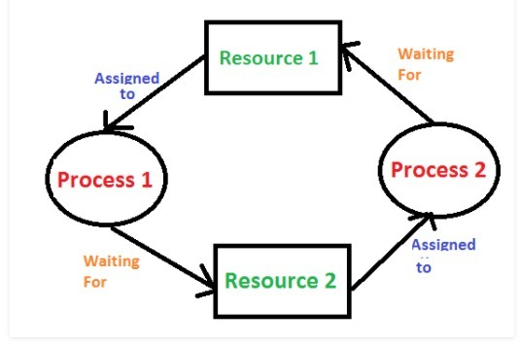
Deadlock is defined as the permanent blocking of a set of processes that compete for system resources, including database records or communication lines.
The main applicability of deadlock avoidance is that it is not necessary to preempt and roll back mechanisms, as in deadlock mechanisms.

Slide 8
Also one of the other applications of deadlock avoidance is decreased restriction then deadlock prevention which makes it easier to implement it. The approach to application of deadlock avoidance is to manipulate to find at least one safe path but knowing that future resource requirements must be known and processes might be waiting for a long time. One of the applications of deadlock avoidance is to allocate all required resources to the process before the start of its execution, this way hold and wait condition is eliminated but it will lead to low device utilization.

Slide 9
IMPLEMENTATION
using AWS INSTANCE

Slide 10

We will be using AWS(Amazon web services) instance rather than a virtual machine.
EC2(Elastic Compute Cloud) instance with an AMI(Amazon Machine Image) is used here which acts as an virtual server to run applications on AWS.
We will set up ubuntu in our EC2 server.

Slide 11
MOTIVATION
The performance of this model is influenced by various factors like Scalability, Reliability, Security, Disaster Management .
The advancement in the Cloud computing model has led to an increase in demand for its services.
Disaster is one of the factors which deteriorate the Cloud performance.
Though it is an unpredictable event it can be prevented if the system is designed with efficient Scheduling, Resource allocation, Load Balancing etc. Disaster management is a challenging task, it provides a platform for a Cloud Service provider to exhibit the best service

Slide 12
Efficient Scheduling – EBS Snapshot memory backup.
Resource allocation – Bankers algorithm
Load Balancing- Throttle algorithm
Deadlock Creation and Avoidance using P-Threads .

Slide 13
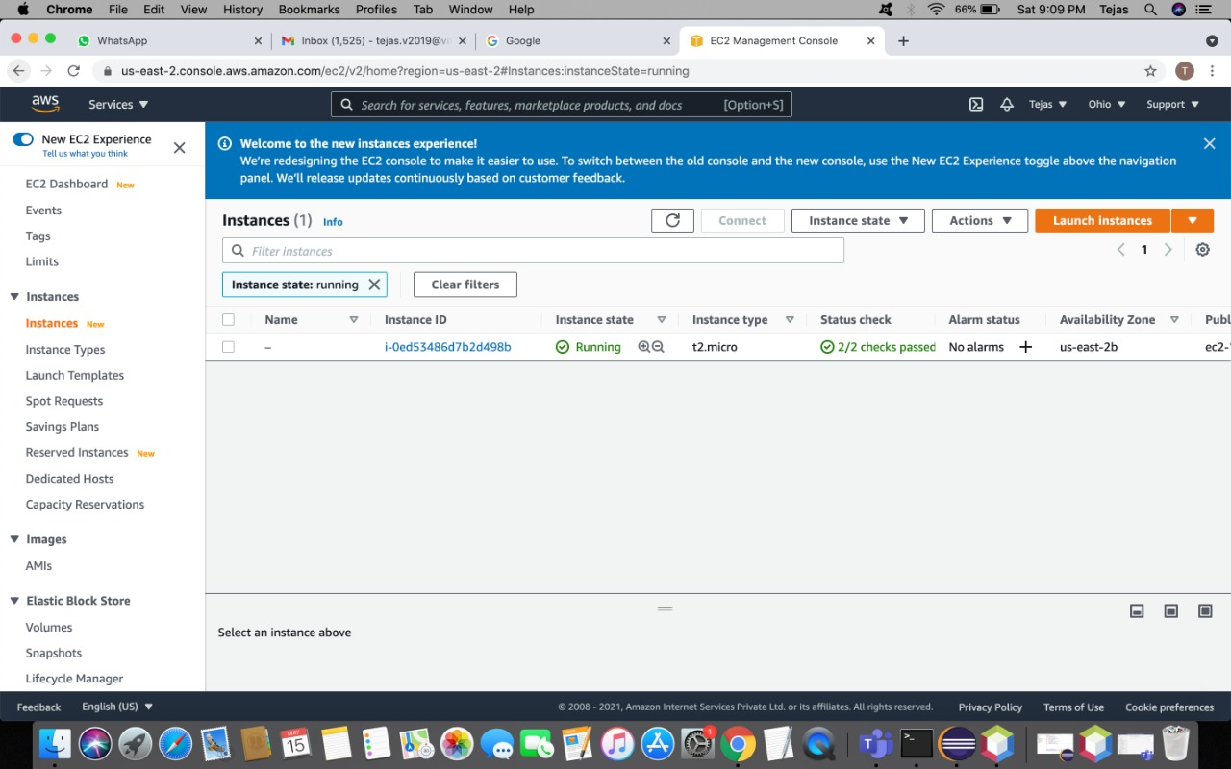
IMPLEMENTATION DETAILS
How to Make Amazon EC2 Instance

Slide 14
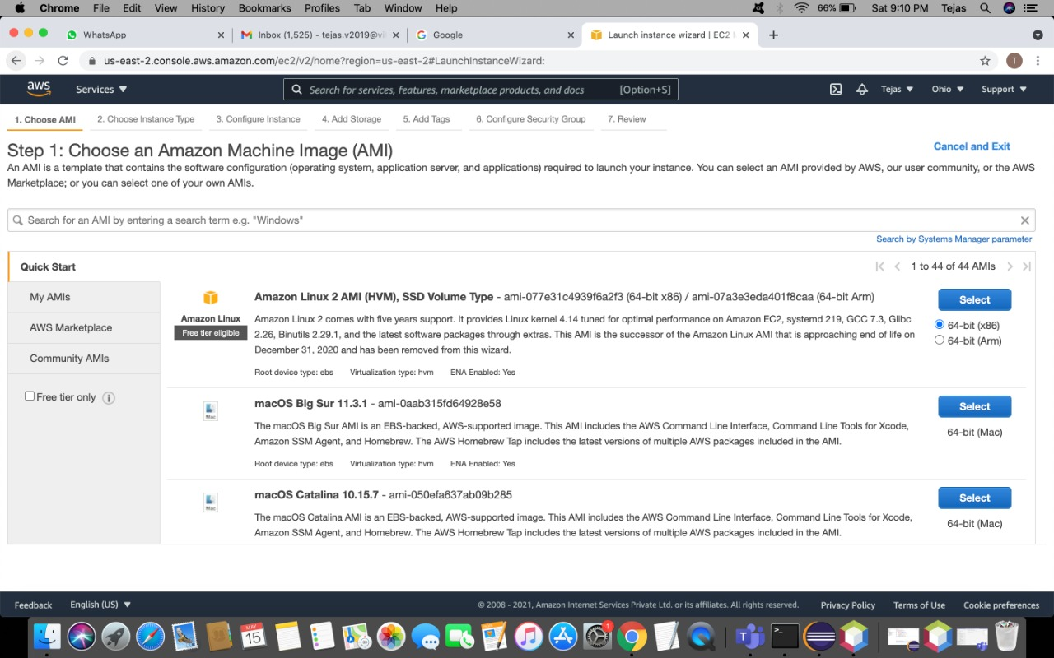
Choose amazon linux 2 AMI

Slide 15
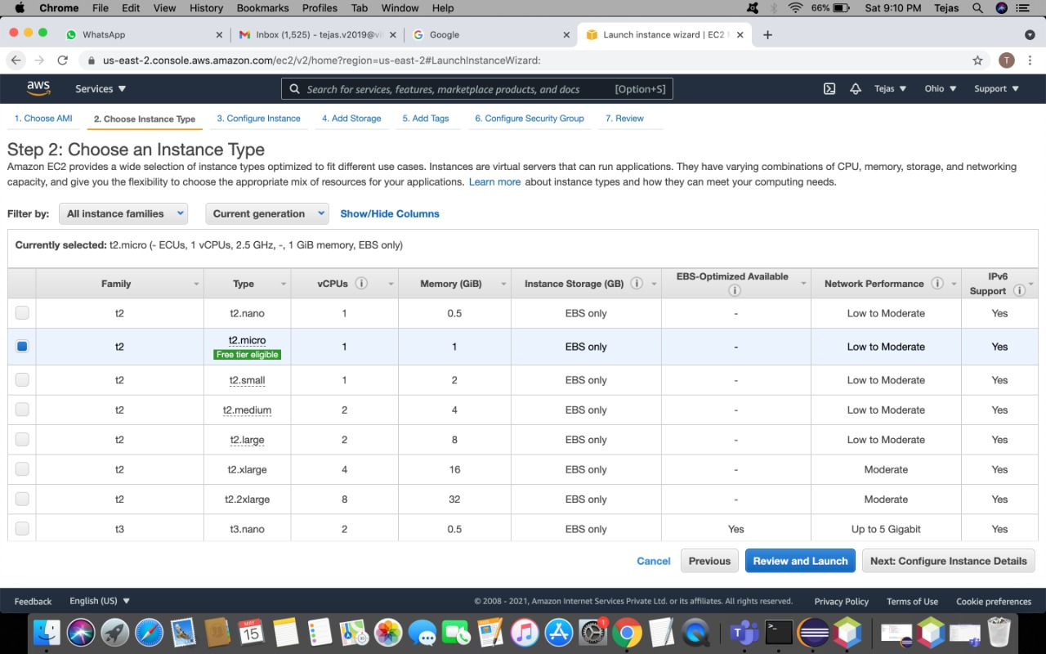
Choose type t2.micro

Slide 16
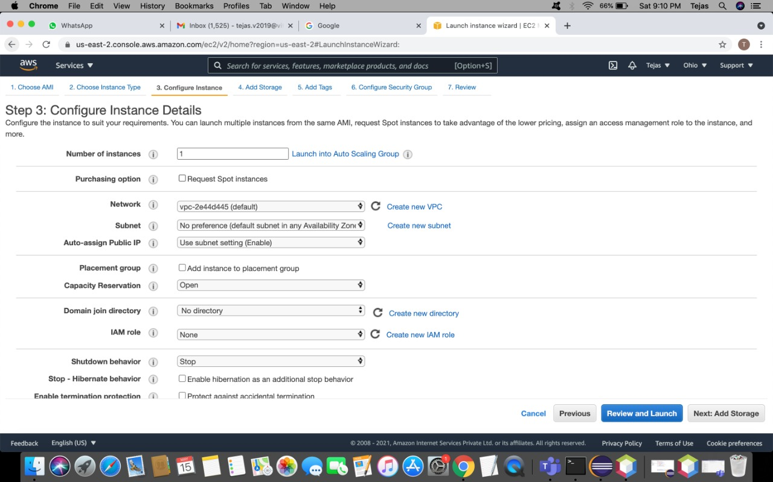
Configure instance details

Slide 17
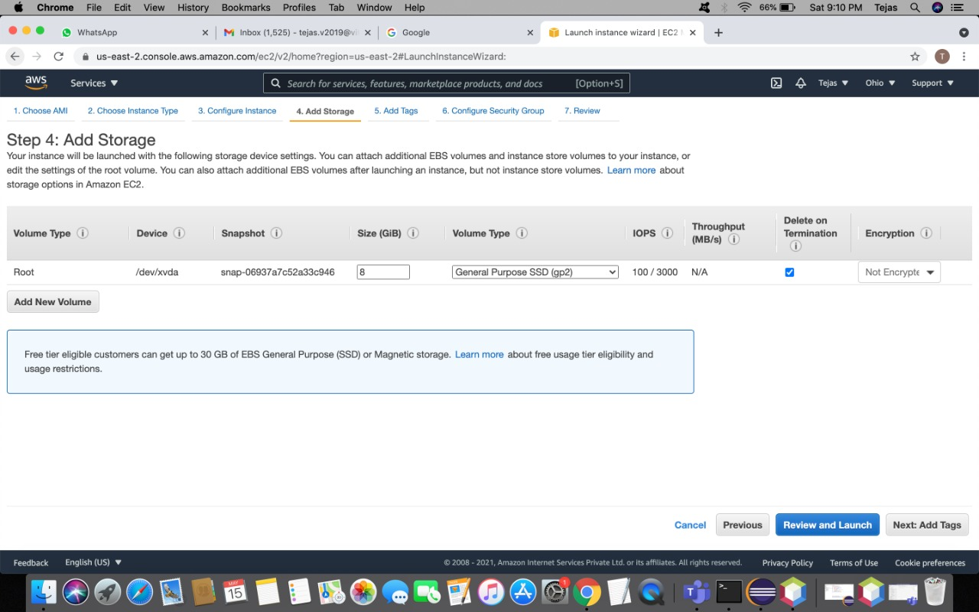
Add storage of your instance according to your need

Slide 18
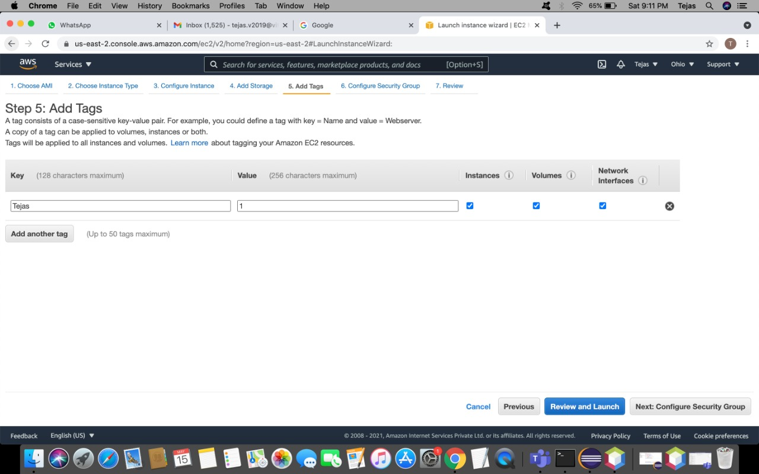
Add tags to make your instance descriptive

Slide 19
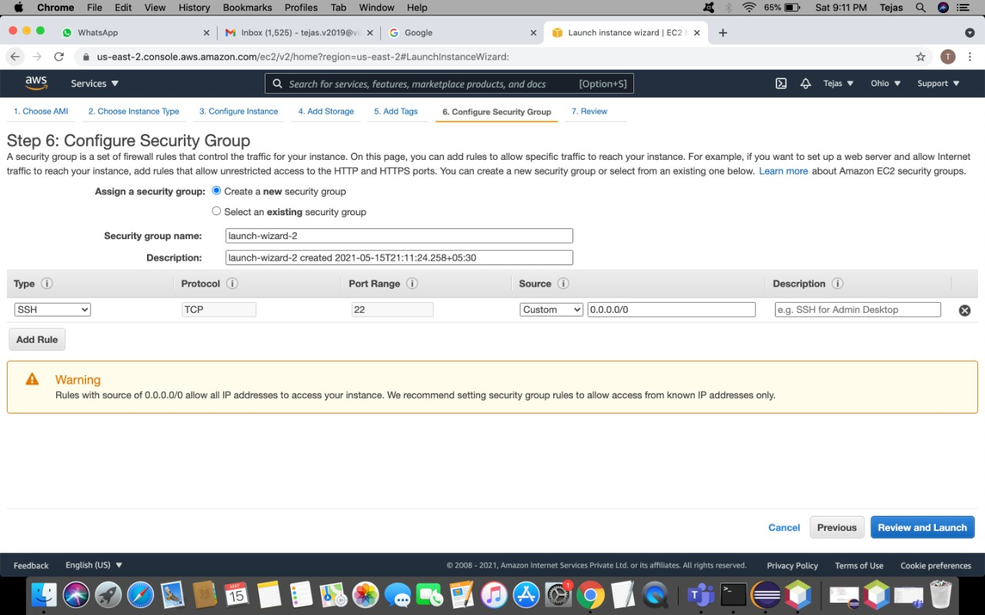
Confirm security group to allow public or private access to your instance

Slide 20
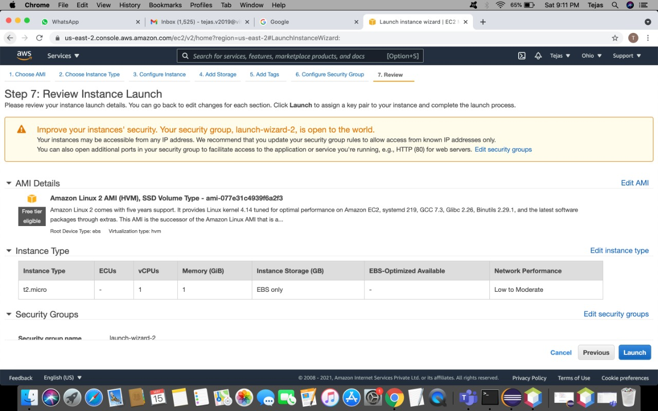
Review of the instance

Slide 21
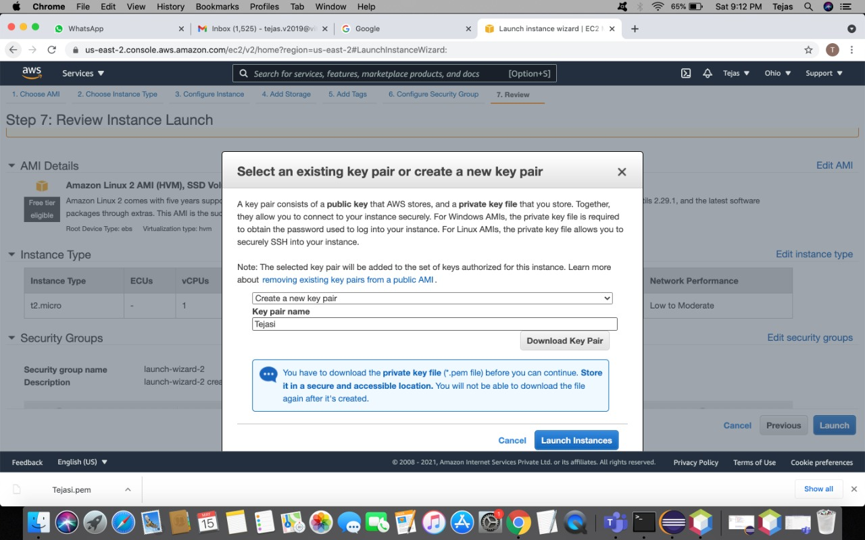
Create a key pair, download it and then convert it to ppk form using putty

Slide 22
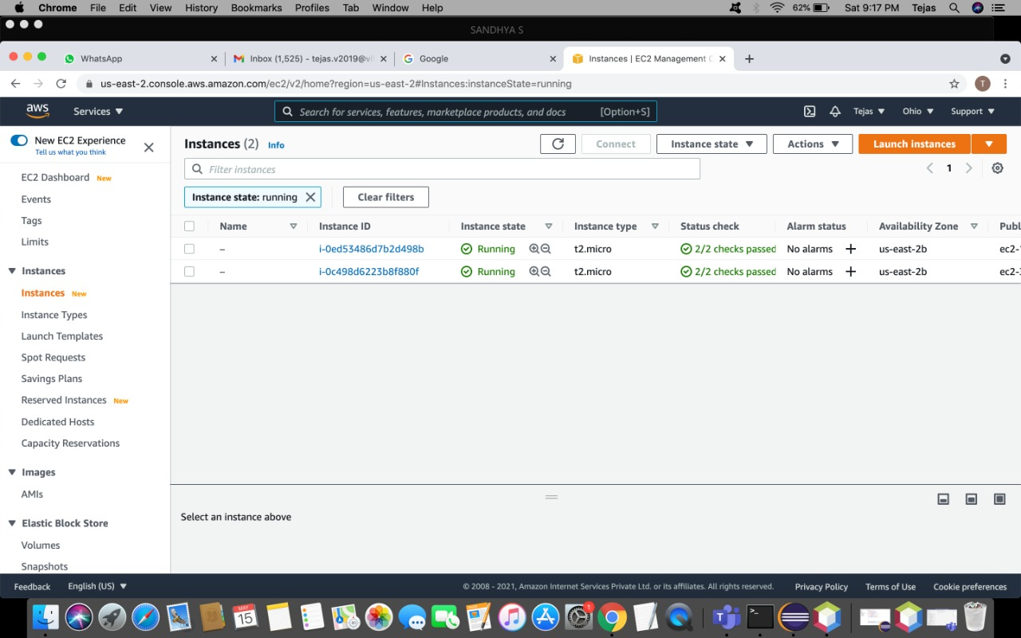
Copy the DNS name from the instance created

Slide 23
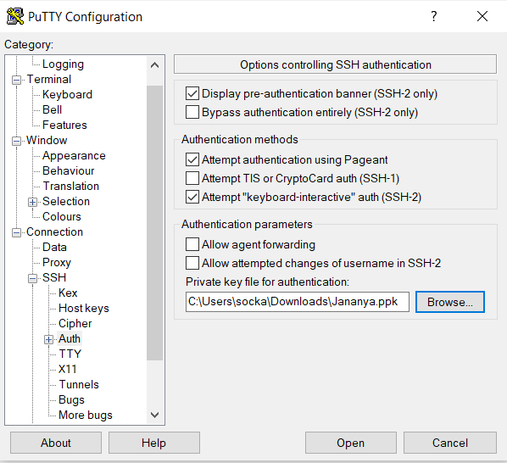
Using putty gen generate the key

Slide 24
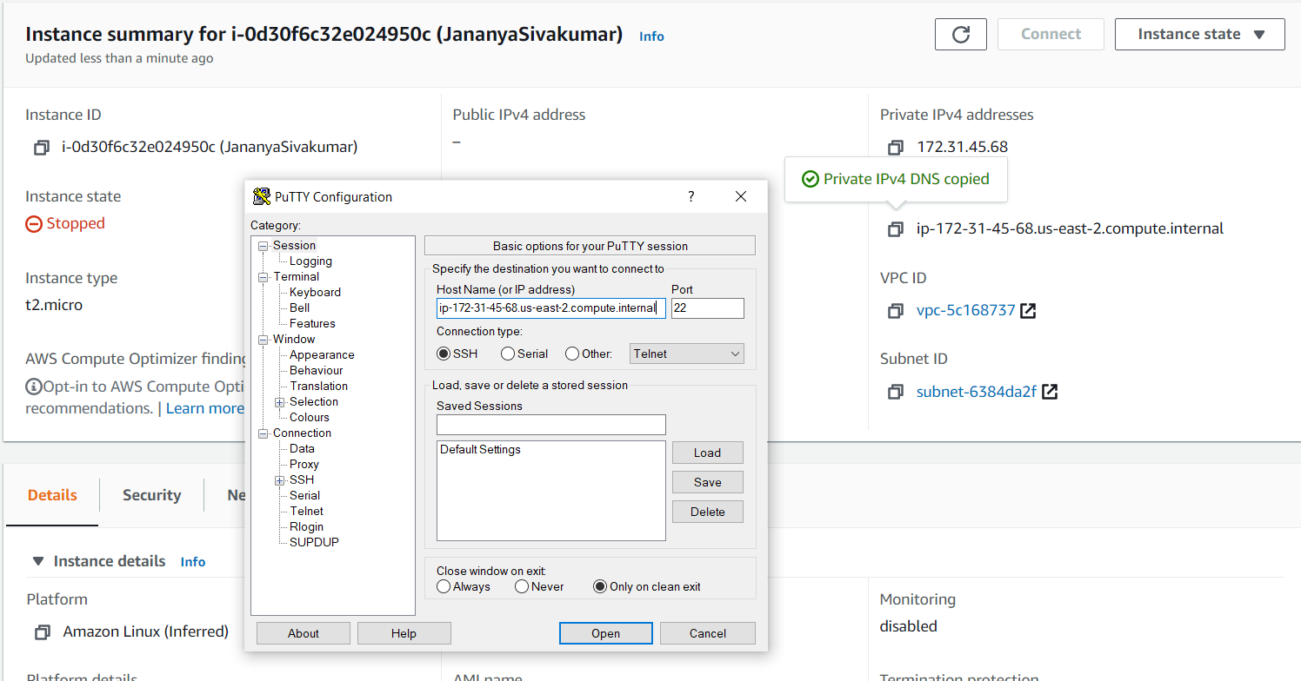
The key will be generated

Slide 25
Banker’s Algorithm :
If Requesti <= Needi
Goto step (2) ; otherwise, raise an error condition, since the process has exceeded its maximum claim.
2) If Requesti <= Available
Goto step (3); otherwise, Pi must wait, since the resources are not available.
3) Have the system pretend to have allocated the requested resources to process Pi by modifying the state as follows:
Available = Available – Requesti
Allocationi = Allocationi + Requesti
Needi = Needi– Requesti

Slide 26
Let Work and Finish be vectors of length ‘m’ and ‘n’ respectively.
Initialize: Work = Available
Finish[i] = false; for i=1, 2, 3, 4….n
2) Find an i such that both
a) Finish[i] = false
b) Needi <= Work if no such i exists goto step (4)
3) Work = Work + Allocation[i] Finish[i] = true goto step (2)
4) if Finish [i] = true for all i then the system is in a safe state

Slide 27
CODE:
#include<stdio.h>
int current[5][5], maximum_claim[5][5], available[5];
int allocation[5] = {0, 0, 0, 0, 0};
int maxres[5], running[5], safe = 0;
int counter = 0, i, j, exec, resources, processes, k = 1;
int main() {
printf("\nEnter number of processes: ");
scanf("%d", &processes);
for (i = 0; i < processes; i++) {
running[i] = 1; counter++;
} printf("\nEnter number of resources: ");
scanf("%d", &resources);
printf("\nEnter Claim Vector:");
for (i = 0; i < resources; i++) {
scanf("%d", &maxres[i]); }
printf("\nEnter Allocated Resource Table:\n");
for (i = 0; i < processes; i++) {
for(j = 0; j < resources; j++) { scanf("%d", &current[i][j]); } }

Slide 28
printf("\nEnter Maximum Claim Table:\n");
for (i = 0; i < processes; i++) {
for(j = 0; j < resources; j++) {
scanf("%d", &maximum_claim[i][j]); } }
printf("\nThe Claim Vector is: ");
for (i = 0; i < resources; i++) {
printf("\t%d", maxres[i]); }
printf("\nThe Allocated Resource Table:\n");
for (i = 0; i < processes; i++) {
for (j = 0; j < resources; j++) {
printf("\t%d", current[i][j]); }
printf("\n"); }
printf("\nThe Maximum Claim Table:\n");
for (i = 0; i < processes; i++) {
for (j = 0; j < resources; j++) {
printf("\t%d", maximum_claim[i][j]); }
printf("\n"); }
for (i = 0; i < processes; i++) {
for (j = 0; j < resources; j++) {
allocation[j] += current[i][j]; } }
printf("\nAllocated resources:");

Slide 29
for (i = 0; i < resources; i++)
{ printf("\t%d", allocation[i]); }
for (i = 0; i < resources; i++)
{ available[i] = maxres[i] - allocation[i];
} printf("\nAvailable resources:");
for (i = 0; i < resources; i++) { printf("\t%d", available[i]); } printf("\n");
while (counter != 0) {
safe = 0; for (i = 0; i < processes; i++)
{ if (running[i]) {
exec = 1;
for (j = 0; j < resources; j++) {
if (maximum_claim[i][j] - current[i][j] > available[j]) {
exec = 0; break;
} }

Slide 30
if (exec) {
printf("\nProcess%d is executing\n", i + 1);
running[i] = 0;
counter--;
safe = 1;
for (j = 0; j < resources; j++) {
available[j] += current[i][j]; }
break;
} } }
if (!safe) { printf("\nThe processes are in unsafe state.\n");
break; }
else { printf("\nThe process is in safe state");
printf("\nAvailable vector:");
for (i = 0; i < resources; i++) { printf("\t%d", available[i]); } printf("\n");
} }
return 0;
}

Slide 31
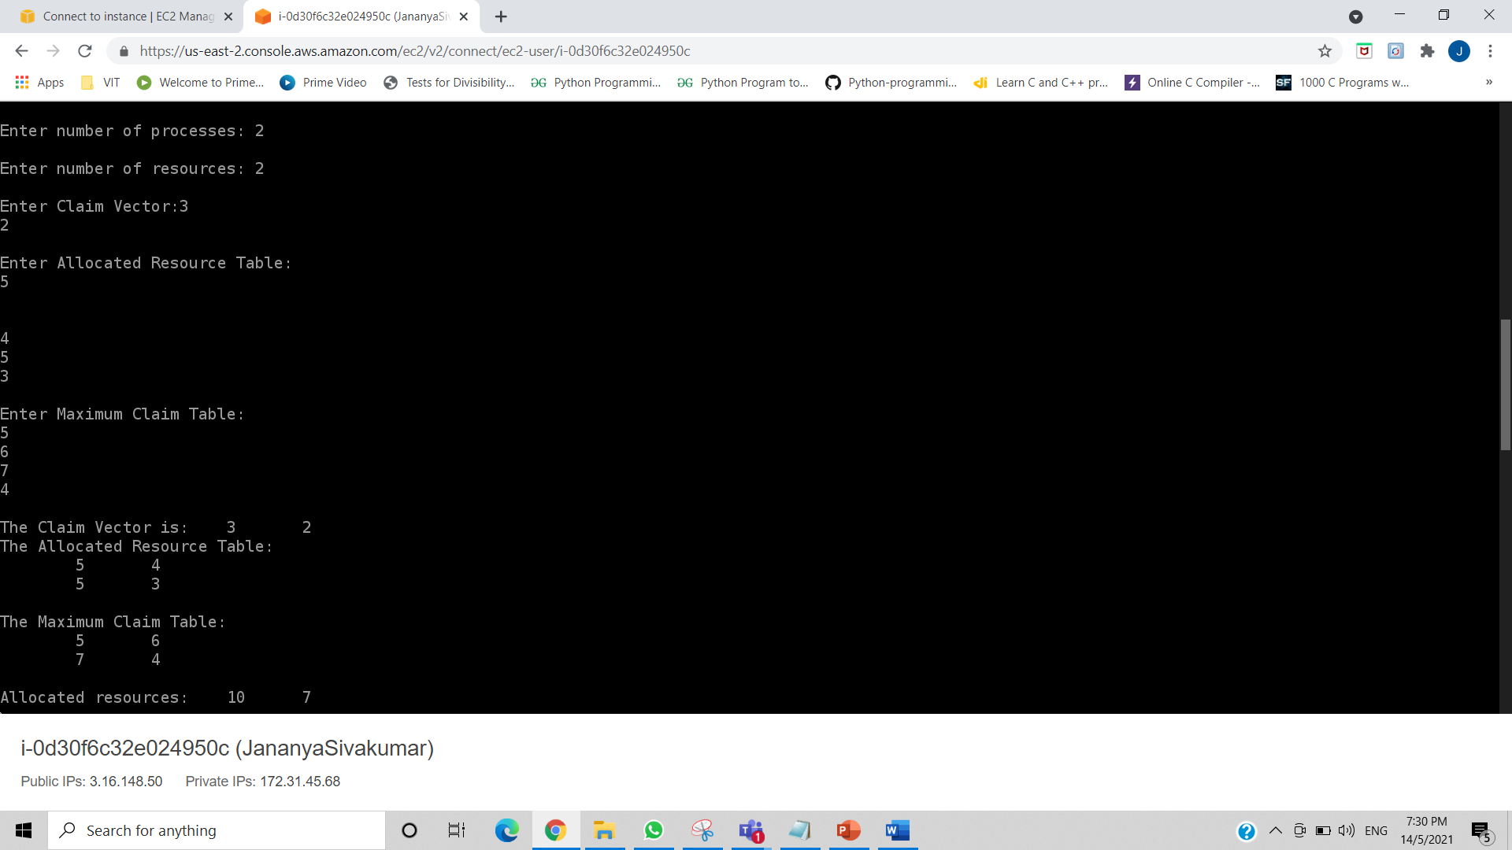
OUTPUT

Slide 32
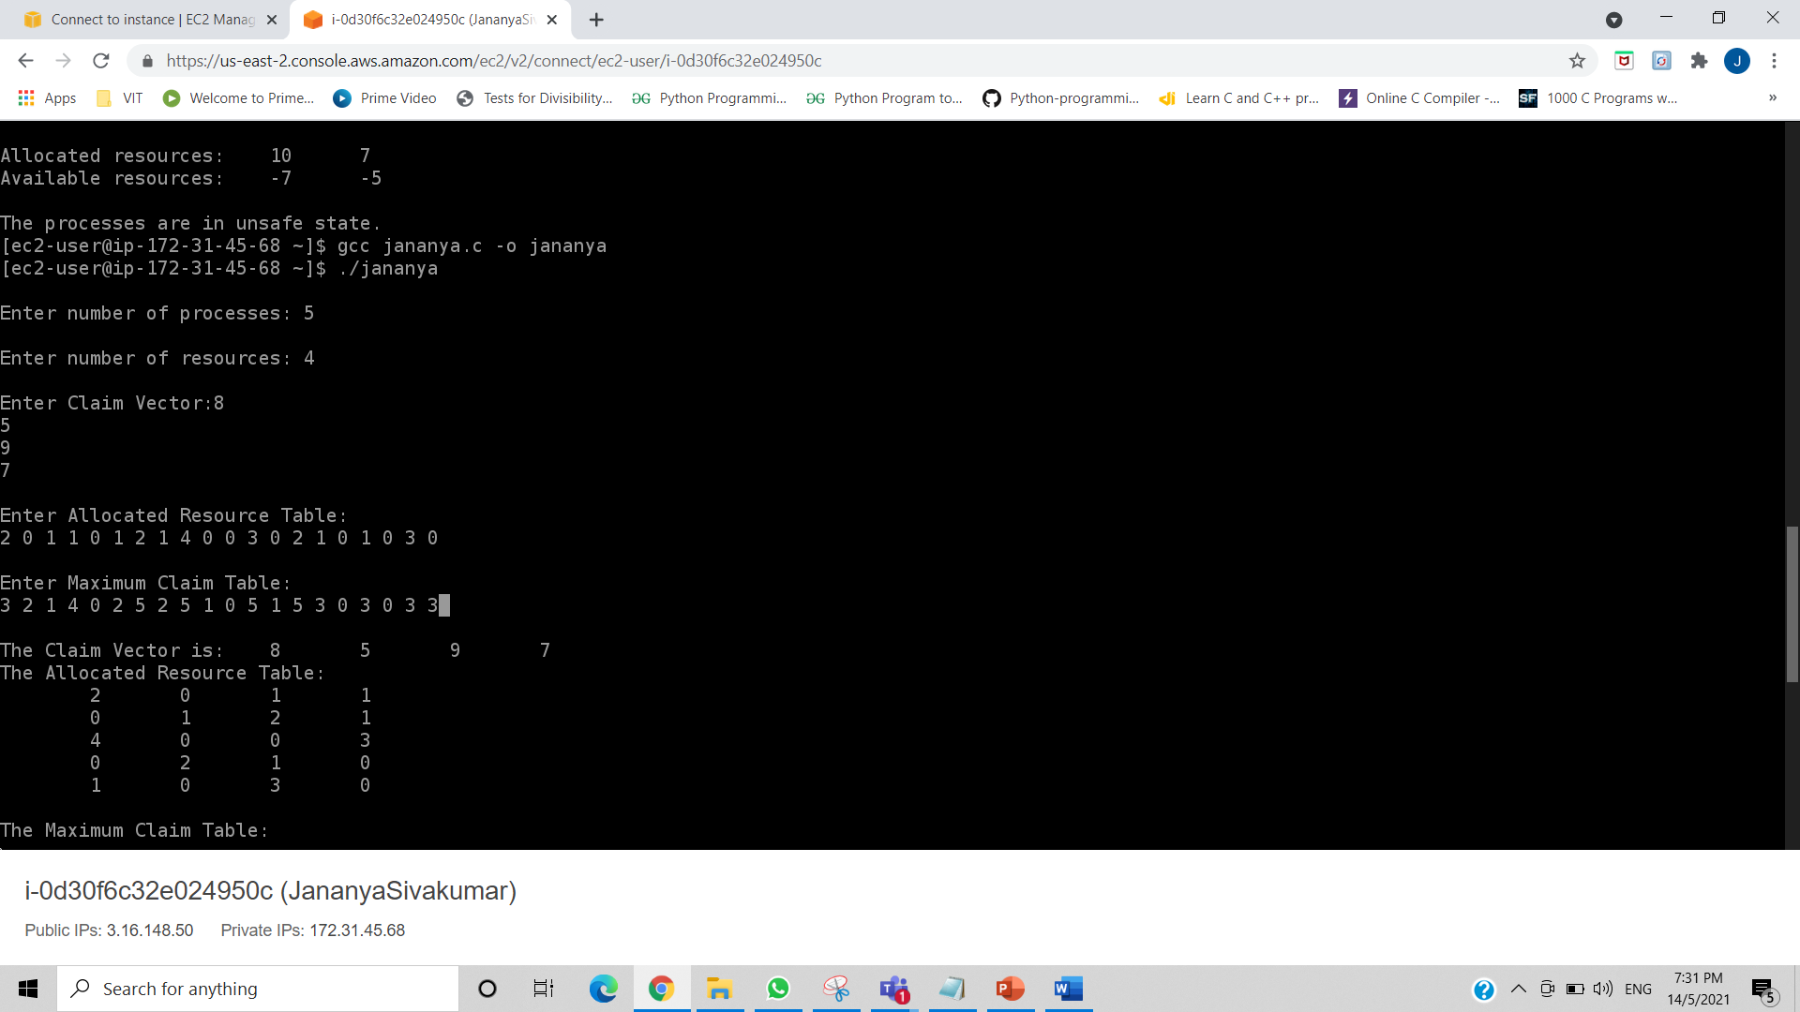

Slide 33
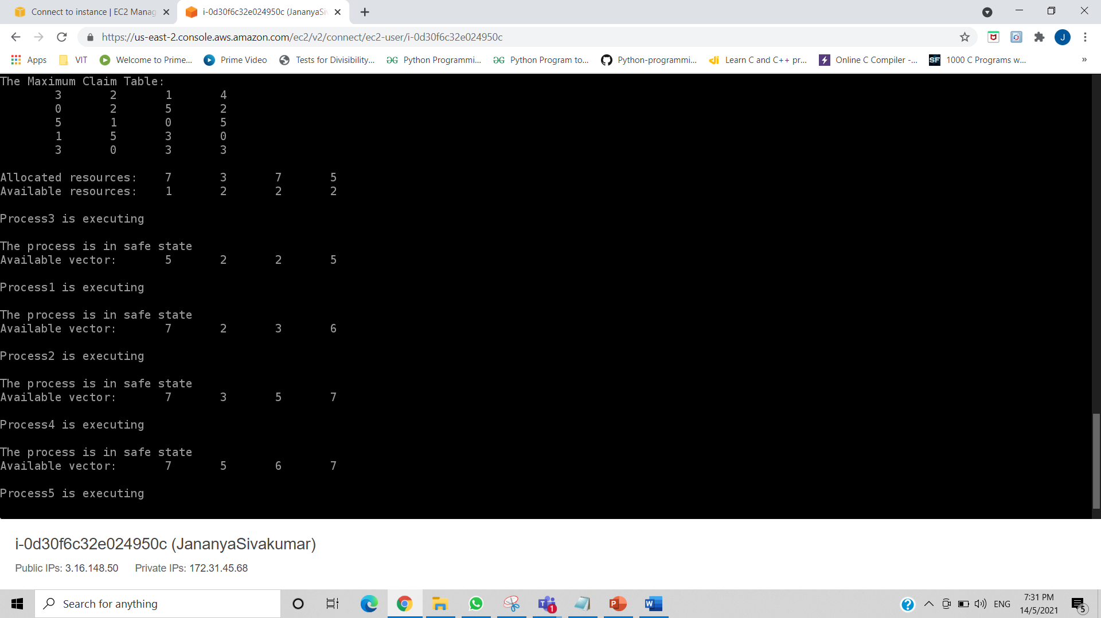

Slide 34
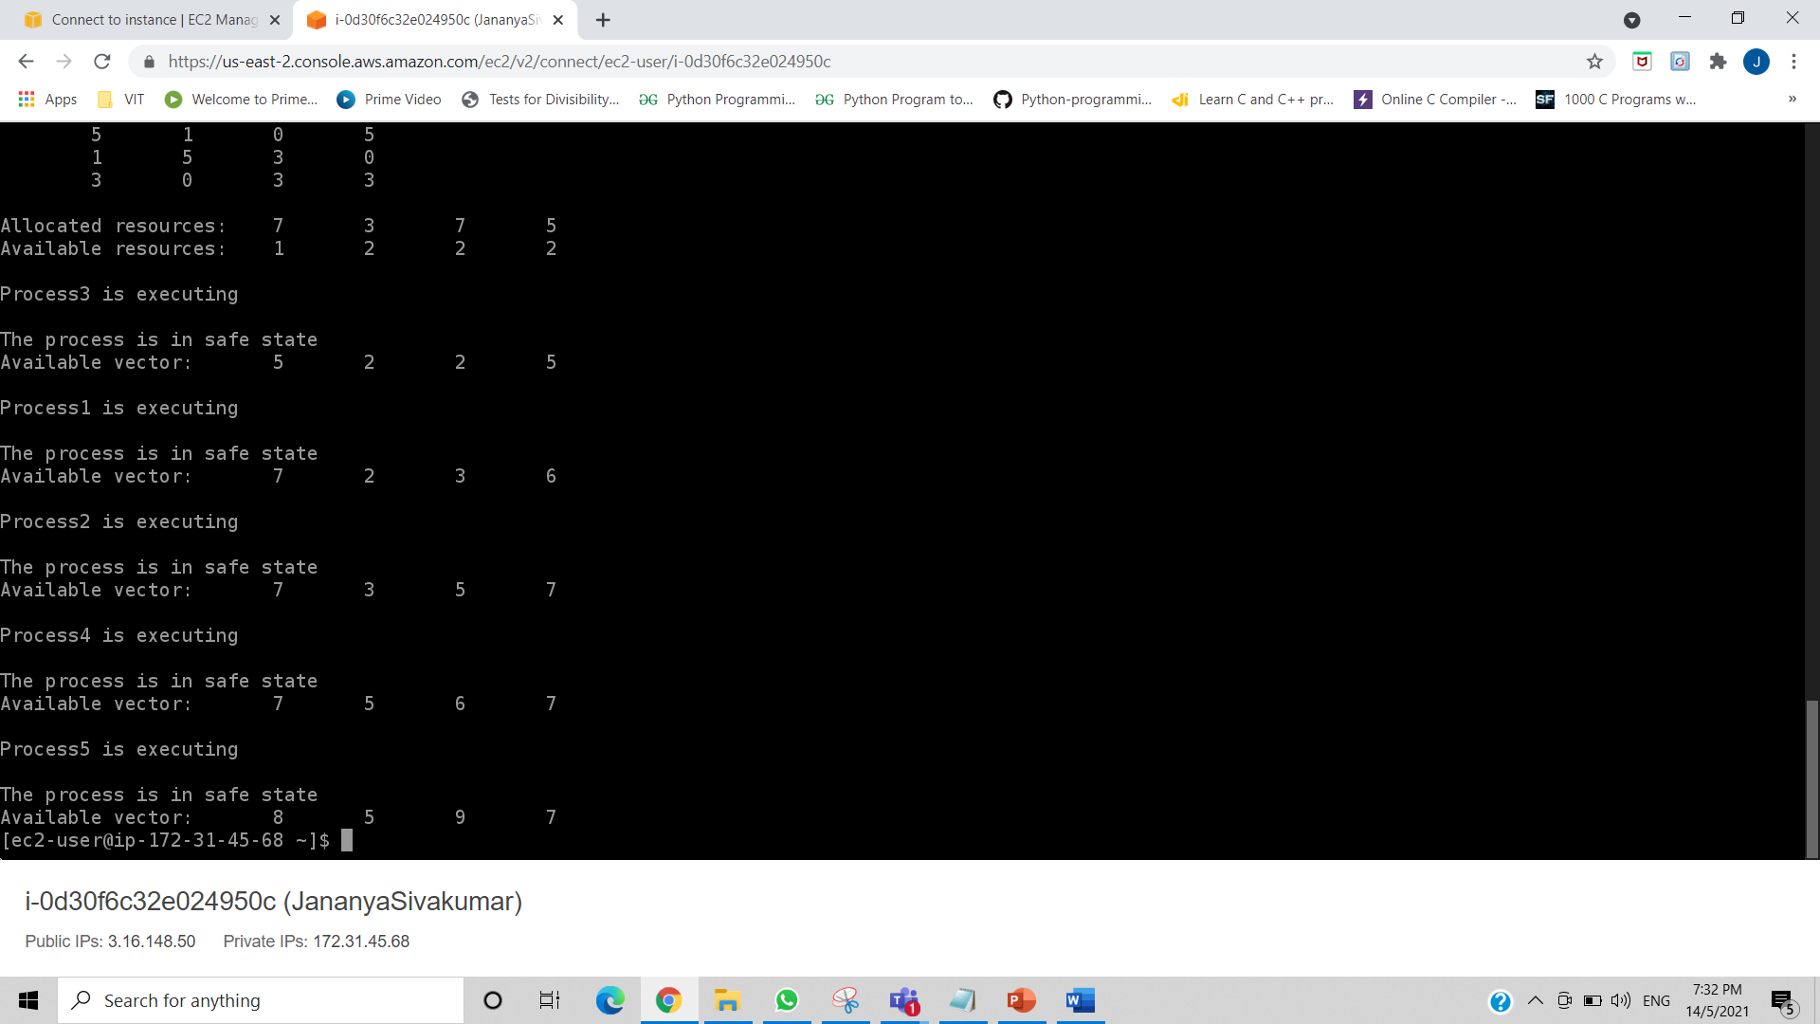

Slide 35
REFERENCES
International Journal of Modern Trends in Engineering and Research (IJMTER) Volume 02, Issue 03, [March - 2015]

